Slide 1
Predicting Medicare Advantage Plan Medical Loss Ratio
Chris Ventura

Slide 2
Background
What is Medicare?
What is Medicare Advantage?
What is Medical Loss Ratio?
Why should we care?

Slide 3
Problem
Many factors influencing plan’s MLR beyond control of plan
Similar to other industries, understanding market influence is key to decision-making
My goal is to use a set of models to better understand the impact of market and plan forces on a health plan’s MLR

Slide 4
Datasets
Dataset | Key Features | Use
2014 MA Plan MLR dataset | MLR, Plan Contract ID | “Hub”, outcome variable
2014 Contract Info | SNP Indicator | Aggregation of other files
2014 County Plan Enrollment | Enrollment by County | Aggregating county benchmarks to plan level
2014 Plan Risk Score | Plan Risk Score, Plan Average Payment | Features for model
2014 County Risk Score | County Avg. Risk Score, County Avg. payment | Aggregated to model features
2014 County MA Penetration | County Penetration Rate | Feature for model
2014 STARS Summary | STARS Quality Ratings, Parent Organizations | Features for model

Slide 5
Feature Selection
Plan Characteristics
Plan Risk Score | Measure of health of plan’s membership
Plan Avg. Payment | Avg. monthly payment a plan receives
Network Type | PPO, HMO, etc.
Organization Type | National, Blue, Regional
STARS Quality Rating | Measure of health outcomes and customer satisfaction
[MLR]
Market Characteristics
Market Risk Score | Measure of health of market
Market Avg. Payment | Avg. monthly payment for all plan’s in market
Market Penetration | Number of enrollees in MA divided by number of all Medicare enrollees

Slide 6
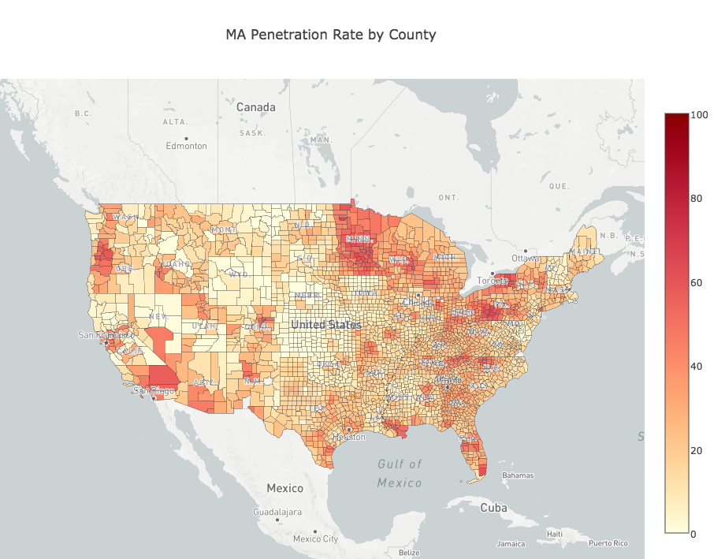
Penetration Rate by County
Adoption varies heavily by region
Markets at different levels of maturity
Stark differences, even within states

Slide 7
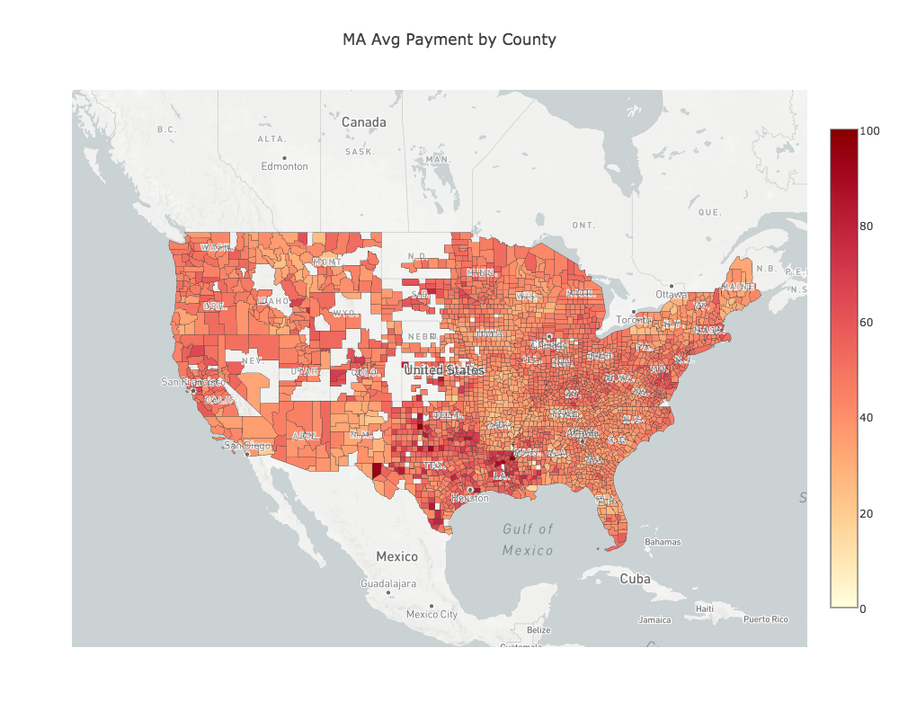
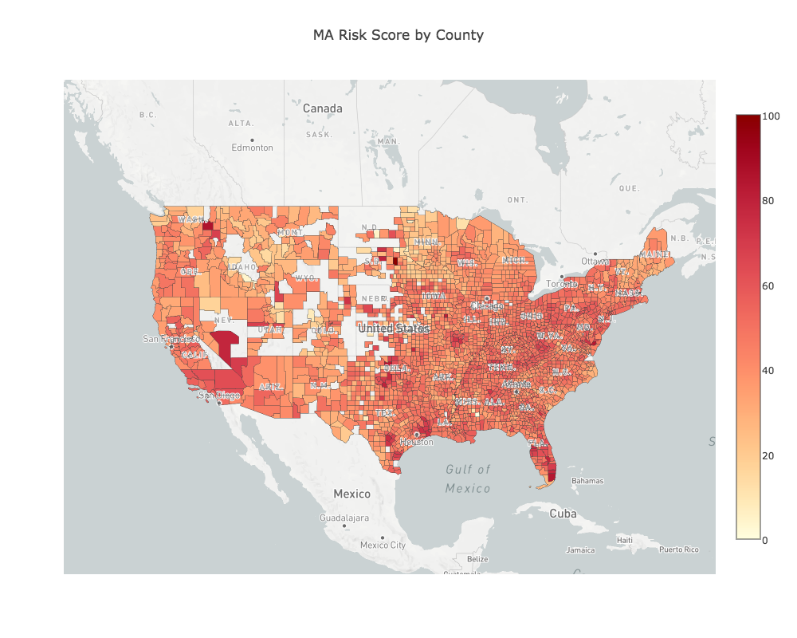
Risk Score and Average Payment by County

Slide 8
Models
Random Forest
Area Under Curve | 0.79
Key Features | Risk Score (.262)
 | Market Average Penetration (.256)
 | Average Payment (.246)
 | National Carrier (.051)
Logistic Regression
R-Squared | 0.8349
AUC | 0.753
Linear Regression
R-Squared | 0.2812
MSE | .0047

Slide 9
Conclusion
Random Forest and Logistic Regression outperform Linear Regression
Leads me to believe that profitable plans do share similar characteristics, but the relationship is far from linear for most of the features
In all models, plan characteristics outweigh market characteristics, with exception of penetration rate
Leads me to believe that, while market forces do play some part, a plan’s own operations are more important to their overall success
Some surprising results with variable correlations/predictability

Slide 10
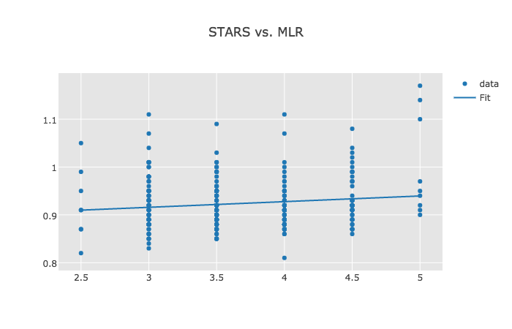
STARS vs. MLR

Slide 11
Areas for Further Research
Incorporate multiple years
Analyze changes across years
Incorporate county demographic data
Apply Ridge Regression
Perform more variable analysis to determine candidates for combination

